Slide 1

Start Your Engines:
5 Ways to Grow Your Distributorship Fast
David Blaise
Top Secrets of Promotional Products Sales
www.SmartEQP.com

Slide 2
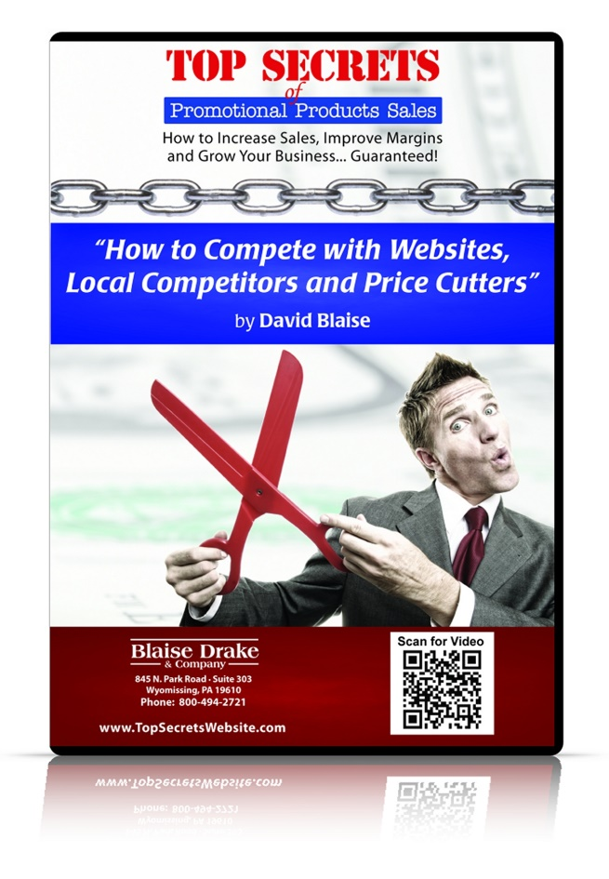
A Gift Before We Begin…
Get a Free Copy of the Audio CD Training Program & Mini-Poster “How to Compete with Websites, Local Competitors and Price Cutters”
Be one of the first 100 people to stop by the Top Secrets of Promotional Products Sales Tradeshow Booth and use the password below:
1160
Bring the Flyer to Booth #___________
Use the Password: ________________
Grow-1

Slide 3
Start Your Engines:
5 Ways to Grow Your Distributorship Fast
Identifying high dollar buyers
  What constitutes a high dollar buyer for you?
  Who are the high dollar buyers in your market?
  What percentage have you identified?
  How many of them know you’re alive?
  What is your plan for approaching them and
  when do you start?

Slide 4
Start Your Engines:
5 Ways to Grow Your Distributorship Fast
Positioning yourself as the only viable solution
  What is your ideal client looking for?
  How can you deliver that better than anyone else?
  How will you explain it?
  How will you communicate it?
  How will you reinforce it?

Slide 5
Start Your Engines:
5 Ways to Grow Your Distributorship Fast
Getting your first order from a new client
  How will you get your foot in the door?
  How will you demonstrate confidence and competence?
  How will you qualify them?
  How will you know what to recommend?
  How will you get them to pull the trigger?

Slide 6
Start Your Engines:
5 Ways to Grow Your Distributorship Fast
Converting one-time buyers into multi-buyers
  What is your post-sale follow-up process?
  How will you acknowledge your clients?
  How will you evaluate the success of your promotions?
  How will you determine what’s next?
  What is your reorder reminder process?

Slide 7
Start Your Engines:
5 Ways to Grow Your Distributorship Fast
Multiplying your client base
  What is your process for getting referrals?
  How can you spread like a virus?
  How do you gather and display testimonials?
  How many case studies have you collected?
  How many similar prospects can you identify?

Slide 8
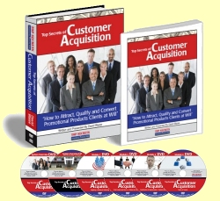
Next: Your Questions. Now: A 60 Second Commercial
“If You’re Ready to Grow Your Distributorship Fast, I’d Love to Help!
Why Not Test-Drive Top Secrets of Customer Acquisition Risk-Free in Your Business for One Full Year?”
You Get:
  A complete, proven system that attracts, qualifies & converts clients like crazy
  Procedures for Targeting Hunting & Gathering clients online and offline
  Letter templates for your First Contact mailings
  Phone and voicemail scripts for your 3 x 3 Follow-up Procedure
  A 7 Step Bulletpoint Qualification Procedure
  The Five Stages of Qualification
  A Guide to Examining the Metrics
  The Top Secrets of Customer Acquisition Training Guide and Journal
  Risk-Free: Full-Year, Iron-Clad, Money-Back Guarantee!
Regular: $497 Show special: $347
Room special:
$297

Slide 9
Questions?

Slide 10
One Final Thought
“Growth is never by mere chance;
it is the result of forces working together.”
- James Cash Penney

Slide 11
Start Your Engines:
5 Ways to Grow Your Distributorship Fast
David Blaise
Top Secrets of Promotional Products Sales
www.SmartEQP.com

